Slide 1
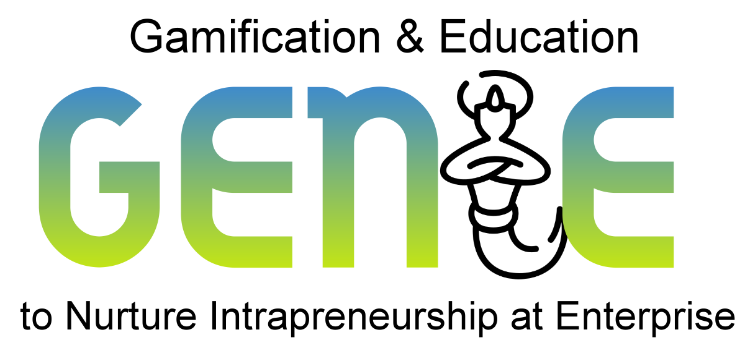
genieproject.eu
Making things happen 2:
Intrapreneurial attitude, conflict and change management within MSMEs

Slide 2
Index
1
Intrapreneurial attitude
1.1 Definition
1.2 The 4 principles of intrapreneurial attitude: relation to the organization, satisfaction, motivation and intention
2
Change management
2.1 Definition
2.2 Change management models
2.3 Implementing change in your company
3
Conflict management
3.1 Definition
3.2 The Harvard Model
3.3 Exercise

Slide 3
Objectives
At the end of this module you will be able to:
To be aware of what is meant by intrapreneurial attitude and its 4 principles
To realize how important change management is and how to implement it in your business
What is conflict management and what can you do if a conflict arises in your company

Slide 4
Unit 1
Intrapreneurial attitude
1.1 Definition
1.2 The 4 principles of intrapreneurial attitude: relation to the organization, satisfaction, motivation and intention

Slide 5
1. Intrapreneurial attitude
1.1 Definition
For a deeper understanding of intrapreneurship from an individual perspective, we first look at the personality of the intrapreneur.
Personality plays a role in the intention to become an entrepreneur and also in the entrepreneurial success.
The personality concept contains stable motives, attitudes and the orientation of the experiences and actions of individuals, so it has an influence on both entrepreneurship and intrapreneurship.
The organizational environment plays a significant role in intrapreneurial behavior, but it does not sufficiently explain why an individual ultimately decides to behave entrepreneurially.
The most entrepreneurial initiatives have specific dynamic capabilities that have a positive impact on business performance.
Source no.: 7
Picture Source: Pixabay

Slide 6
1. Intrapreneurial attitude
Conscientiousness
Dependability
Grit
Organization
Persistence
Planning
Punctuality
Responsibility
Agreeableness
Collaboration
Collegiality
Generosity
Honesty
Integrity
Kindness
Trustworthiness
1.1 Definition
The five dimensions of the personality concept with reference to intrapreneurship:
Big
Five
Extraversion
Assertiveness
Cheerfulness
Communication
Optimism
Leadership
Liveliness
Sociability
Emotional Stability
Confidence
Coping with Stress
Moderation
Resilience
Self-Esteem
Self-Consciousness
Self-Regulation
Definition:
In summary, extraversion, openness and conscientiousness can be considered as those personality traits that are most likely to have an influence on intrapreneurship.
Openness to Experience
Curiosity
Creativity
Global Awareness
Growth Mindset
Imagination
Innovation
Tolerance
Source no.: 2

Slide 7
1. Intrapreneurial attitude
1.1 Definition
Individual
Intrapreneurial behavior
Innovativeness
Proactiveness
Opportunity recognition/ exploitation
Risk-taking
Networking
As mentioned earlier, the organizational environment plays a significant role in intrapreneurial behavior, but it does not sufficiently explain why an individual ultimately decides to behave entrepreneurially.
The graphic shows that intrapreneurial behavior is influenced by intrapreneurial attitudes and characteristics. Therefore, it is important to recognize these as influencing factors
Intrapreneurial attitudes
Relation to the organization
Satisfaction
Motivation
Intention
Intrapreneurial characteristics
Skills/ abilities
Perception of their own capabilities
Personal knowledge
Past experience
In this training course we are going to concentrate on intrapreneurial attitude and how it can influence intrapreneurship in your company
Source no.: 3

Slide 8
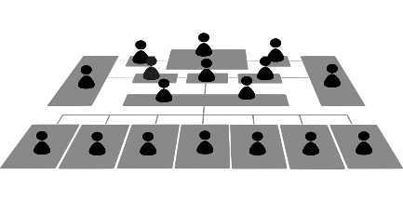
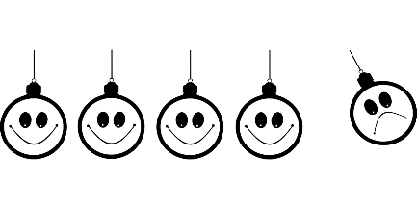
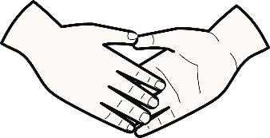
1. Intrapreneurial attitude
1.2 The 4 principles of intrapreneurial attitude
A special relevance arises from intrapreneurial behavior, as it can result in new leadership opportunities.
Traditional leadership is based on the known, security and experience. However, intrapreneurial leadership is based on the unknown. Detailed information is needed to make decisions so that risks can be minimized. This is under the condition that the necessary resources are granted by the company.
It is necessary for an intrapreneur to take calculable risks, to experiment, to use existing knowledge and to get the maximum out of the available resources. Decisions are always adjusted as new information comes in.
Intrapreneurial attitude
Relation to the organization
Satisfaction
Motivation
Intention
Source no.: 4
Picture Source: Pixabay

Slide 9
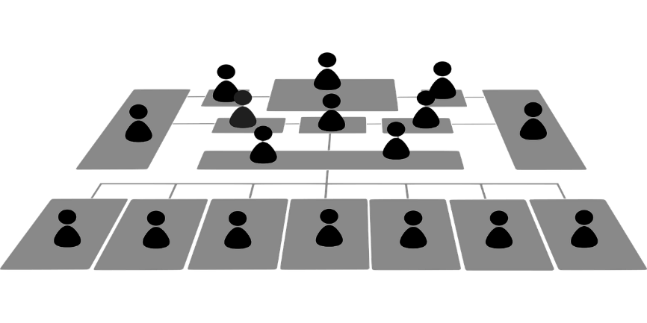
1. Intrapreneurial attitude
1.2 The 4 principles of intrapreneurial attitude
Relation to the organization
Trust in the direct supervisor is an important prerequisite for entrepreneurial behavior.
Support from the owner/entrepreneur is an important key element that promotes intrapreneurship.
Encouraging employees helps to manifest intrapreneurial behavior.
“Psychological ownership" is seen as a mediator of the relationship between a person and their organization. This creates a feeling among employees that organizational goals are their own.
If individuals have the feeling of being part of something, the goals are evaluated as more positive.
Reminder!
The more the employee relates to the organization, the more it influences entrepreneurial actions and ultimately entrepreneurial behavior
Source no.: 5
Picture Source: Pixabay

Slide 10
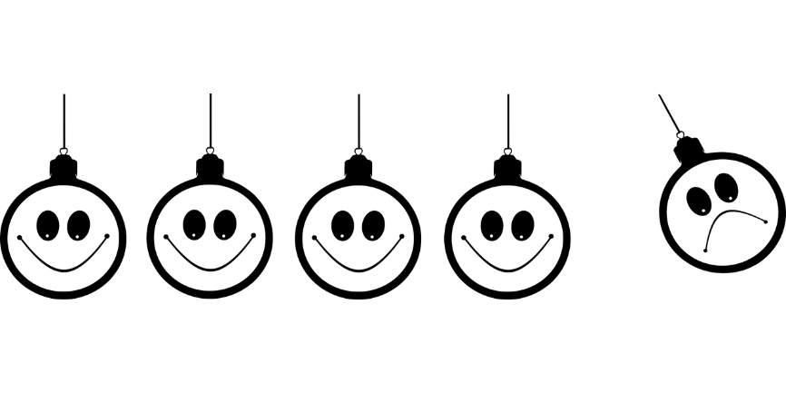
1. Intrapreneurial attitude
1.2 The 4 principles of intrapreneurial attitude
Satisfaction
Job satisfaction is considered an important element because in the context of intrapreneurship it has a positive impact on the sustainability and growth of the company.
The accumulated work experiences of employees are a component of satisfaction.
The feeling of satisfaction can be increased and positively influenced by granting employees autonomous action.
Strengthening the relationship with the organization and delegating ownership, management can promote satisfaction in the company through rewards and compensation.
Reminder!
The more the employee is satisfied, the more it influences entrepreneurial actions and ultimately entrepreneurial behavior
Source no.: 5
Picture Source: Pixabay

Slide 11
1. Intrapreneurial attitude
1.2 The 4 principles of intrapreneurial attitude
Motivation
Rewards have an impact not only on satisfaction, but also on the motivation of employees to act intrapreneurially.
Awareness has a direct impact on the time and energy spent on initiatives.
Reward systems should be embedded in companies, as this can improve the quality of work and increase efforts and motivation. This leads to more innovation, risk-taking and ultimately intrapreneurship.
Intrapreneurs are also motivated by the challenges they have mastered. Entrepreneurial employees experience motivation from market-oriented laws or from the desire to create added value from opportunities.
Reminder!
The more the employee is motivated, the more it influences entrepreneurial actions and ultimately entrepreneurial behavior
Source no.: 6
Picture Source: Pixabay

Slide 12
1. Intrapreneurial attitude
1.2 The 4 principles of intrapreneurial attitude
Intention
Intrapreneurial intention refers to the goal of developing a new branch of business, creating a spin-off or diversifying one's organization.
The intention according to which individuals act is a strong indicator of the behaviors that occur.
The extent to which intrapreneurs directly profit from the development of innovative ideas does not play a significant role. They live out their passion, but use the resources made available to them by the company.
The intentions of intrapreneurs are conscious processes. With setting goals, intrapreneurs can, among other things, steer the communication and engagement of companies.
Reminder!
The intention of an employee is a strong indicator for behaviors. With setting goals intrapreneurs can steer communication and engagement
Source no.: 6
Picture Source: Pixabay

Slide 13
Unit 2
Change management
2.1 Definition
2.2 Change management models
2.3 Implementing change in your company

Slide 14
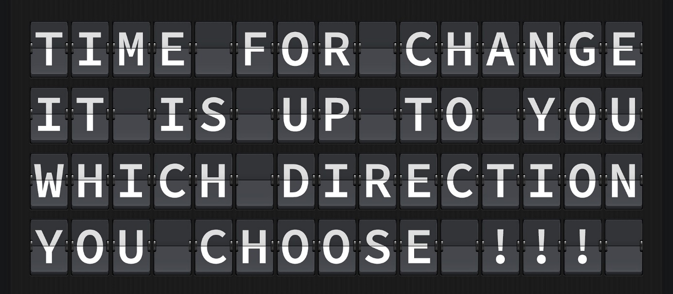
2.Change management
2.1 Definition
Implementing change is not easy especially in small businesses. You have a lot of moving parts, not to mention employees who get nervous about any big changes or shifts.
Managing change is one of those topics that people don’t talk about that much, but is extremely important, whether that’s shifting into a new market or overhauling organizational structure to ensure the long-term health of the company.
Source no.: 10
Picture Source: Pixabay

Slide 15
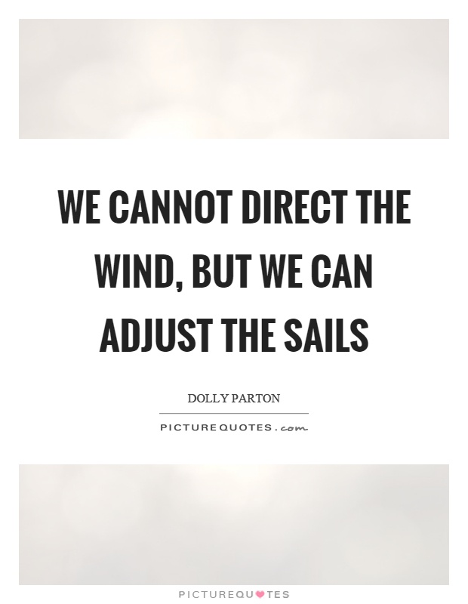
2.Change management
2.1 Definition
The change management process involves preparing individuals and organizations for organizational changes, which may include the adoption of new technology, changes in market demand, responses to competition, business succession planning, and mergers, as examples.
It’s one of the core management principles that covers how to prepare everyone for major changes in a company. The process helps companies to reach long-term aims and objectives with minimal disruption to the organization’s personnel and operations.
We cannot direct the wind, But we can adjust the sails
Source no.: 10
Picture Source: http://www.picturequotes.com/we-cannot-direct-the-wind-but-we-can-adjust-the-sails-quote-383364

Slide 16
2.Change management
2.2 Change management models
Implementing organizational change is uncomfortable and difficult and we all know what is said about change:
“It’s the only constant in life. Realizing this is true is the easy part. Accepting change, especially when it disrupts the way we work or how we live our lives, is a whole different ball game.”
However, that doesn’t mean it’s okay (or beneficial) to force change upon your employees, no matter how dire the need. When change is unwelcome or introduced without preamble, people will resist it.
Change management models are frameworks that guide organizations when navigating and managing change in the workplace. Many models exist, but the following are among the most popular
Source no.: 11

Slide 17
2.Change management
2.2 Change management models
Model 1: Lewin’s change theory
Developed by American social psychologist Kurt Lewin, this organizational change management theory follows a simple and practical three-step process for handling change in general.
Unfreeze
Change
Refreeze
Recognize the need for change
Determine what needs to change
Encourage the replacement of old behaviors and attitudes
Ensure there is strong support from management
Manage and understand the doubts and concerns
Plan the changes
Implement the changes
Help employees to learn new concept or points of view
Changes are reinforced and stabilized
Integrate changes into the normal way of doing things
Develop ways to sustain the change
Celebrate success
Source no.: 11
Picture Source: https://online.visual-paradigm.com/de/diagrams/templates/lewins-change-model/lewins-3-stage-model/

Slide 18
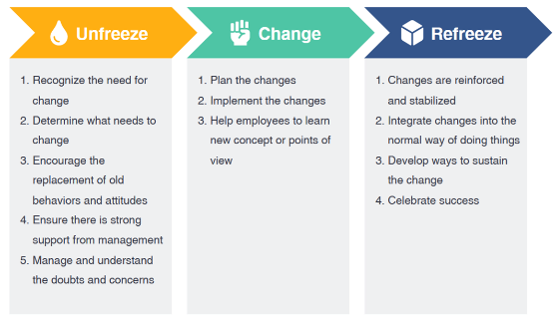
2.Change management
2.2 Change management models
Model 1: Lewin’s change theory
Step 1 – Unfreezing
Before you can remold an ice cube into a sphere or some other shape, it first has to melt, in other words, you’ll have to unfreeze it. Many employees don’t like change. At this stage of the process, your goal is to prepare them for change.
Communicate how old procedures, structures, and thought processes are hindering the company from achieving growth, becoming competitive, and maintaining profitability.
The more they understand the rationale behind the change, the more they know how it benefits them, then the more likely they are to cooperate.
Recap
Start with an in-depth examination to clearly understand the current state and why “change” must occur.
Listen to the voices of people, their doubts & concerns, remain open and address those concerns, and steer and align them towards the change.
Source no.: 11, 12

Slide 19
2.Change management
2.2 Change management models
Model 1: Lewin’s change theory
Step 2 – Changing
Once people have been “unfrozen” from old beliefs and systems, they’re ready to proceed to the next step - the changing, also called the moving or transitioning phase. It’s when the actual change process occurs. Employees learn new methods and procedures.
They adopt new ways of thinking and behaving. As this stage is rife with uncertainty, fear, stress, and worry, communication and employee support are extremely vital.
Recap
Describe the benefits of change, use all channels to communicate effectively, and paint a visual picture.
Generate and celebrate short-term wins to reinforce the change.
Source no.: 11, 12

Slide 20
2.Change management
2.2 Change management models
Model 1: Lewin’s change theory
Step 3 – Freezing
People have embraced the new ways of working and changes are taking shape.
The freezing stage, which is also sometimes called refreezing is, when the change finally becomes part of the employees’ “new normal.” This final step is critical because without reinforcement, people may go back to their old habits, systems, and ways of thinking
Recap
Identify what supports the change, what barriers are to maintaining the change, and how to sustain the change. Provide training and support, and establish a feedback & reward system. Adapt & adjust the organization structure where necessary.
Source no.: 11, 12

Slide 21
2.Change management
SKILLS
2.2 Change management models
STRATEGY
STAFF
Model 2: McKinsey’s 7-S model
The 7-S framework is used to define and analyze the essential elements of an organization. The model views an organization in a holistic manner, with seven interconnected components.
The seven elements are mutually supportive and must therefore be fully aligned for an organization to be effective.
SHARED
VALUES
STRUCTURE
STYLE
SYSTEMS
Picture Source: https://www.mbamanagementmodels.com/mckinseys-7-s-framework/
Source no.: 11, 13

Slide 22
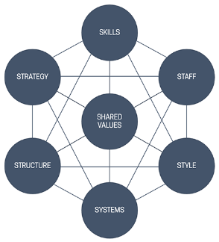
2.Change management
2.2 Change management models
Model 2: McKinsey’s 7-S model
Style
Skills
Systems
An organization’s informal rules and conduct, behavior patterns, the work culture, or how things are done within the company.
Individual and institutional skills that make up an organization’s competencies and capabilities.
Procedures and processes the organization has in place. Examples are risk management processes, and client management systems.
Source no.: 11, 13

Slide 23
2.Change management
2.2 Change management models
Model 2: McKinsey’s 7-S model
Structure
Staff
Strategy
Shared
values
The organization’s structure or how business units and divisions are organized, including the authority relationships within that structure.
Reminder
Each element is equally important and valuable. When using the 7-S model to diagnose your company, all the elements must work together and align with one another.
The people in the company, their qualities, how talents are grown and developed, and each working role’s characteristics and attributes, such as education and attitude.
What the company is doing to build competitive advantage.
Standards, beliefs, and principles that form the foundation of an organization’s culture. They guide how employees behave and, over time, provide the identity by which the company is known.
Source no.: 11, 13

Slide 24
2.Change management
Create
a sense of urgency
2.2 Change management models
Institute
change
Build
a guiding coalition
Model 3: Kotter change model
John Kotter (1996), a Harvard Business School Professor and a renowned change expert, developed his model on the basis of research of 100 organizations which were going through a process of change.
The 8 steps in the process of change include: creating a sense of urgency, forming powerful guiding coalitions, developing a vision and a strategy, communicating the vision, removing obstacles and empowering employees for action, creating short-term wins, consolidating gains and strengthening change by anchoring change in the culture.
Sustain
Acceleration
The Big
Form
a strategic vision
opportunity
Generate
short-term wins
Enlist
a volunteer army
Enable
action by removing barriers
Source no.: 14

Slide 25
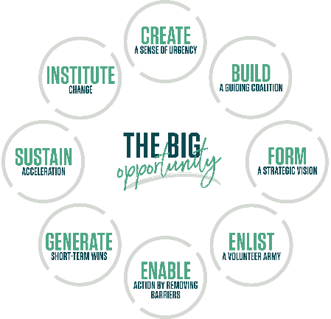
2.Change management
2.2 Change management models
Model 3: Kotter change model
Step 1:
Create a sense of urgency:
Motivate employees to embrace change by communicating and highlighting the importance of taking immediate action.
Step 2:
Build a guiding coalition:
The team you put together will champion change within the organization. Its members should possess a range of skills and experience and must come from various areas of the business.
Step 3:
Form a strategic vision:
Create a relatable, inspiring, and easy-to-understand vision that conveys what the future looks like and how you intend to turn that vision into reality.
Source no.: 14

Slide 26
2.Change management
2.2 Change management models
Model 3: Kotter change model
Step 4:
Enlist a volunteer army:
Get buy-in from all levels of the organization. The team or guiding coalition you’ve built should communicate the vision continuously. The goal is to incite people to move in the same direction and, ultimately, drive change.
Step 5:
Enable action by removing barriers:
Remove roadblocks that limit your initiative’s chances of success. These may include people (help them understand the vision and how they benefit from it), legislation and cultural barriers (different cultures and how to accommodate them).
Step 6:
Generate short-term wins:
Implementing change can be a long and grueling process. Recognize short-term wins that exemplify the benefits of the change early and often, so people stay motivated.
Source no.: 14

Slide 27
2.Change management
2.2 Change management models
Model 3: Kotter change model
Step 7:
Sustain acceleration:
The journey will get tough at some point, but never give up. Don’t become complacent about early successes and risk losing your focus. Be relentless and keep on pushing until the objectives of the change are in place.
Step 8:
Institute change:
Reinforce change by rewarding adopters and continuously communicating the benefits -- until the change replaces old habits and becomes part of the workplace culture.
Reminder
A change always takes place in a multi-stage process. In order to prevent errors in the change process, a company must go through all the stages described above. In practice, the model is easy to use, as all stages are specifically described.
Source no.: 14

Slide 28
2.Change management
Reminder
You will encounter multiple change management models, but generally, they involve the same three steps:
2.3 Implementing change in your company
1. Communicate change to employees
Communicating with employees the importance of the change and discussing any benefits the change would bring. The purpose is to cultivate buy-in from team members and to address any culture changes that might result. Changes of this magnitude often lead to logistical issues, and the preparation process aims to deal with that too.
2. Cultivate a plan
Once everyone is prepared to undertake the organizational change, you must create a plan to ensure everything goes smoothly, maximizing the benefits of the transition while minimizing the negative impacts.
Everybody develops goals in line with the changes and establishes tangible success metrics. Next, they assign duties and responsibilities. They frame the change within the proper scope and incorporate feedback from team members.
Source no.: 10

Slide 29
2.Change management
2.3 Implementing change in your company
3. Implement the change
With everyone prepared and plans in place, the final step is implementation. It follows the framework and steps outlined in the plan, empowering employees to take ownership of their individual responsibilities. It maintains high levels of accountability to ensure everyone executes in their assigned roles, tracking the progress of the transition and long-term adherence to the plan. They evaluate the results and tweak as necessary.
Source no.: 10

Slide 30
Unit 3
Conflict management
3.1 Definition
3.2 The Harvard Model
3.3 Exercise

Slide 31
3.Conflict management
3.1 Definition
A conflict management system is a comprehensible management system that encompasses the entire company and, on the basis of a defined strategy for dealing with conflicts, comprises an orderly and sustainable procedure with the following elements (functionalities): Identification, analysis, evaluation and handling of all conflicts relevant to management, documentation and communication of conflict management.
[Cultural Structures]
[Competence structures]
[Identification structures]
[Processing structures]
[Communication structures]
[...deepening and expanding of the basic structures!]
Source no.: 8

Slide 32
3.Conflict management
What is needed for successful conflict management?
Conflict management at work is always also a task of the corporate culture and of course also of the superiors.
However, in order for conflict management to be successful and to function, it also needs the assistance of the team and the necessary conditions at the workplace.
Thus, there are some necessary requirements for successful conflict management:
Conflict skills
Communication
Willingness to compromise
Control
3.1 Definition
The aim of conflict management
is to systematically deal with the triggers and causes, not least in order to mitigate future conflicts.
It is about...
to manage existing conflicts.
proactively resolve necessary conflicts.
prevent unnecessary conflicts.
Source no.: 8

Slide 33
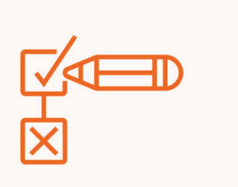
When problems lead to opportunities...
3.Conflict management
3.2 The Harvard Model
The 4 Fundamentals of Principled Negotiations
The Harvard concept of win-win negotiation is a good way to find efficient solutions:
Probably no concept has influenced negotiation strategists more over the past 20 years than win-win - that is, a lasting outcome, often based on compromise, that makes both parties happy.
PEOPLE
INTERESTS
OPTIONS
CRITERIA
Separate people from problems
Focus on interests, not positions
Generate options for mutual benefit
Use Objective Criteria
Source no.: 15
Picture Source: Getting to Yes, Roger Fisher and Wiliam Ury, of the Harvard Negotiation Project

Slide 34
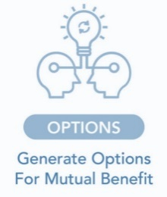
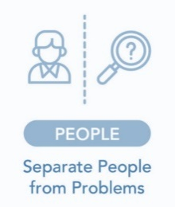
3.Conflict management
3.2 The Harvard Model
The 4 principles:
Develop options that are a win-win situation for both sides!
Treat people and problems separately!
It is important in a negotiation not to become fixated on one solution. Be aware of your own goals and interests, but also take into account those of your counterpart. Work out alternative solutions together and keep a flexible both/and attitude!
Separate factual and relationship levels. This separation is important because people often tend to misinterpret factual statements or even mix them with personal aspects. In order to be able to focus on the interests of both parties, an unprejudiced and appreciative approach is required.
Source no.: 15

Slide 35
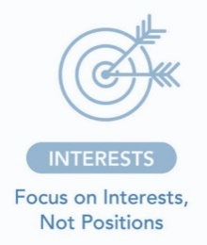
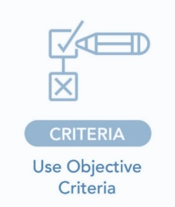
Tip!
If you cannot find a solution internally, it is worth bringing in a coach. Often conflicts are better solved from the outside. Because it is not the conflict itself that is a problem, but the inability to solve it.
3.Conflict management
3.2 The Harvard Model
Treat interests - not positions!
Achieve a fair and neutral result for both sides!
In order to achieve a reasonable result in a negotiation that satisfies both parties, it is important to reconcile the interests of both negotiating partners. It is therefore necessary to talk about the respective interests so that they can be taken into account by the other party. The positions, on the other hand, are often more difficult to bring to the same denominator and are therefore guided by the interests.
Now you have to decide on the solution that best represents your interests and those of your counterpart. Include both positions and talk extensively with your negotiating partner about what he or she thinks is a fair and acceptable outcome. However, also be open to criticism. In the end, the final decision should be based on objective criteria and negotiation. Do not forget that the decision must in any case be practically implementable.
Source no.: 15

Slide 36
Objective
Is to get both parties focused in on what someone is saying rather than focusing on just “winning” an argument.
3.Conflict management
3.3 Exercise
Example:
Companies should offer unlimited holidays to everyone
Step 1:
Split the team up into pairs and ask them to decide who is “A” and who is “B” for the purposes of this next exercise.
Step 2:
Pick a topic that is controversial in nature.
Think of some relevant topics at the time of you using this exercise.
Step 3:
Each pair has 5 minutes to win the argument. Person A will argue for the motion. Person B will argue against it.
Step 4:
After the 5 minutes ask the following:
How did everyone find it?
Any lessons?
How did you feel?
Source no.: 16

Slide 37
Objective
Is to get both parties focused in on what someone is saying rather than focusing on just “winning” an argument.
3.Conflict management
3.3 Exercise
Have the same debrief as before. The comments will amuse you.
See who said the most buts.
Step 5:
Using the same topic both parties will have 5 minutes again but this time neither of them is allowed to use the word “But”
Each pair need to keep a tally of how many buts they used.
Step 6:
Once again both parties will have 5 minutes. Give them a different topic and different sides and this time they are not allowed to use “But” or “However”
Debrief again.
Step 7:
Overall debrief. Ask…
Did you find that you listened harder?
Did you find that you had to respond to what the other person was saying? Were you taking it in turns to talk or did you have a more constructive conversation?
What learning can you take forward?
Source no.: 16

Slide 38
3. What are the 5 dimensions of the personality concept in regard to intrapreneurship?
Conscientiousness, agreeableness, emotional stability, openness to experience, extraversion
Laziness, stubbornness, instability, faultiness, introvert
Biased, aloof, disrespectful, fragile, distrustful
Test your knowledge!
Please answer the following questions:
1. What are the 4 principles of intrapreneurial attitudes?
Proactiveness, risk-taking, networking, innovativeness
Relation to the organization, satisfaction, motivation, intention
Skills, perception of own capabilities, personal knowledge, past experience
4. What are change management models?
Frameworks that guide organizations when navigating and managing change in the workplace
Guidelines how to implement conflicts
A defined strategy for dealing with conflicts and comprises
2. What are the 4 principles if the Harvard method of principled negotiations?
Concept, motivation, implementation, stabilization
People, interests, options and criteria
Quantitative and measurable, results-oriented, ambitious, scheduled
5. What are the 3 steps of the Lewin’s change theory?
Structure, style, strategy
Build coalition, form vision, sustain acceleration
Unfreeze, change, freeze/refreeze

Slide 39
3. What are the 5 dimensions of the personality concept in regard to intrapreneurship?
Conscientiousness, agreeableness, emotional stability, openness to experience, extraversion
Laziness, stubbornness, instability, faultiness, introvert
Biased, aloof, disrespectful, fragile, distrustful
Test your knowledge!
Solutions
1. What are the 4 principles of intrapreneurial attitudes?
Proactiveness, risk-taking, networking, innovativeness
Relation to the organization, satisfaction, motivation, intention
Skills, perception of own capabilities, personal knowledge, past experience
4. What are change management models?
Frameworks that guide organizations when navigating and managing change in the workplace
Guidelines how to implement conflicts
A defined strategy for dealing with conflicts and comprises
2. What are the 4 principles if the Harvard method of principled negotiations?
Concept, motivation, implementation, stabilization
People, interests, options and criteria
Quantitative and measurable, results-oriented, ambitious, scheduled
5. What are the 3 steps of the Lewin’s change theory?
Structure, style, strategy
Build coalition, form vision, sustain acceleration
Unfreeze, change, freeze/refreeze

Slide 40
Summing up
Well done! Now you know more about:
What intrapreneurial attitudes are and how the personality is important to encourage intrapreneurship.
What is change management and how you can implement change management systems into your company/team.
What is conflict management in a company and how a conflict can be solved within the company.

Slide 41
Bibliography (1)
Woo, H. (2018). Personality traits and intrapreneurship: the mediating effect of career adaptability. Career Development International.
Farrukh, M. et al. (2016). Intrapreneurial behavior: an empirical investigation of personality traits. Management & Marketing. Challenges for the Knowledge Society, Vol. 11, No. 4, pp. 597-609.
Neessen, P. et al. (2019). The intrapreneurial employee: toward an integrated model of intrapreneurship and research agenda. International Entrepreneurship and Management Journal.
Mohedano-Suanes, A. & Garzon, D. (2018). Intrapreneurs: Characteristics and Behavior. 10.
Mustafa, M.J. et al. (2016). Psychological Ownership, Job Satisfaction, and Middle Manager Entrepreneurial Behavior. Journal of Leadership & Organizational Studies. 23. 272-287.
Chan, K.Y. et al. (2017). Who Wants to Be an Intrapreneur? Relations between Employees’ Entrepreneurial, Professional, and Leadership Career Motivations and Intrapreneurial Motivation in Organizations.

Slide 42
Bibliography (2)
Zhao, H. et al. (2010). The Relationship of Personality to Entrepreneurial Intentions and Performance: A Meta-Analytic Review. Journal of Management, Vol. 36 No. 2, March 2010 381- 40.
Knobloch, Thomas (2014): Konfliktmanagement in mittelständischen Unternehmen. Spektrum der Mediation 53/2014.
Samantha David (2021): Intrapreneurship education– Handlungsempfehlungen zur Gestaltung eines Curriculums für Universtäten. https://epub.jku.at/obvulihs/download/pdf/6751308?originalFilename=true
www.fool.com/the-ascent/small-business/human-resources/articles/change-management/
www.fool.com/the-ascent/small-business/human-resources/articles/change-management-models/
https://leadershipyoda.com/kurt-lewin-three-stages-of-change/
https://www.mbamanagementmodels.com/mckinseys-7-s-framework/

Slide 43
Bibliography (3)
https://www.managementstudyguide.com/kotters-8-step-model-of-change.htm
https://www.kmutoday.ch/ressort/personal-bildung/professionelles-konfliktmanagement/
https://www.mtdtraining.com/blog/a-conflict-management-exercise.htm

Slide 44
genieproject.eu
Thank you!

