Slide 1
genieproject.eu
A user guide introduction to the AARRR! funnel

Slide 2
Index
1
Brief introduction to the Pirates’ funnel aka AARRR! model
1.1 What is the AARRR! Model about? A quick introduction to the Pirates’ funnel
1.2 The AARRR! for intrapreneurs - Why even bother…
1.3 The AARRR! Model in its core essentials – Five steps for metrics’ measurement
1.4 Slight variations largely applicate & valorised into practice - The AAARRR! Model
2
Core stages of the Pirates’ funnel aka AARRR! model
2.1 Acquisition – The lead stage
2.2 Activation – Stimulating further the lead contacts
2.3 Retention – Nurturing customer loyalty
2.4 Revenue – Time to make profit
2.5 Referral – Triggering the word-of-mouth effect and positive externalities

Slide 3
Objectives
At the end of this module you will be able to:
Familiarise with the essentials of growth hacking
Experiment with the five key stages of the pirates’ funnels
Validate into-practice metrics’ analysis for customer retention

Slide 4
Unit 1
Brief introduction to the Pirates’ funnel aka AARRR! model
1.1 What is the AARRR! Model about? A quick introduction to the Pirates’ funnel
1.2 The AARRR! for intrapreneurs - Why even bother…
1.3 The AARRR! Model in its core essentials – Five steps for metrics’ measurement
1.4 Slight variations largely applicate & valorised into practice - The AAARRR! Model

Slide 5
1. Brief introduction to the Pirates’ funnel aka AARRR! model
1.1 What is the AARRR! Model about? A quick introduction to the Pirates’ funnel
The AARRR! Model is a theoretical framework for Growth Hacking and business acceleration introduced for the first time evert in 2007 by Dave McClure – founder of 500 Startup, one of the most important and renewed Venture Capital worldwide.
The concept of Growth Hacking relates to a methodology based on the gathering, processing and experimenting with data at product and marketing channels level to which newly founded organisations rely on to accelerate as fast as possible their penetration of the market and build their customer base.
The very AARRR! Model heavily relies in fact on quantitative analysis and benchmark of metrics to filter which of the available business / investment alternatives are most suitable and feasible at that given time.
The model allows users to fine-tune and optimize the most relevant marketing matrix for the growth and competitiveness of a project, namely customers’ acquisition and retention.

Slide 6
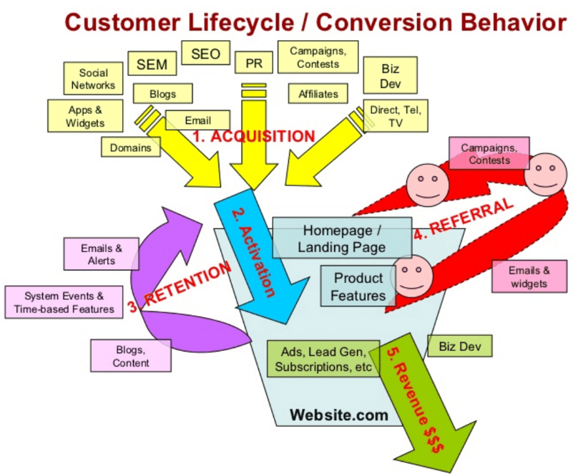
1. Brief introduction to the Pirates’ funnel aka AARRR! model
1.2 The AARRR! for intrapreneurs – Why even bother…
Intrapreneurs share many similarities with startuppers and the (re)application of the AARRR! Model in this different settings might generate significant benefits.
The AARRR! Model might help aspiring intrapreneurs in better understating in the market appetize for their idea (i.e., traction), and in which measure it is feasible for them to transit from the idea stage, through piloting, and into the market.
For reference, here on the right the original introduction of the model from 2007.
Source no.: 1

Slide 7
1. Brief introduction to the Pirates’ funnel aka AARRR! model
1.3 The AARRR! Model in its core essentials – Five steps for metrics’ measurement
The AARRR! Model describes the customer lifecycle in five key stages: each of this stage is fundamental to assure for business growth and continuity. These five stages are:
Acquisition
Activation
Retention
Revenue
Referral

Slide 8
1. Brief introduction to the Pirates’ funnel aka AARRR! model
1.4 Slight variations largely applicate & valorized into practice – The AAARRR! Model
Slight variation of the original model found large application both in specialized literature as well as in practice. This is because per se the model in very flexible and potentially transferable in many different settings.
For instance, some suggested that the very first dimension of this metric assessment should focus on the awareness that people have of the newly available project / product / service.
For some others, although this is indeed very relevant, awareness is more than anything a vanity metric: ancillary evidence that are of great relevance of course but that do not provide for concrete and meaningful measures of the of the growth of a project.
Awareness
Activation
Retention
Revenue
Referral
Acquisition

Slide 9
Unit 2
Core stages of the Pirates’ funnel aka AARRR! model
2.1 Acquisition – The lead stage
2.2 Activation – Stimulating further the lead contacts
2.3 Retention – Nurturing customer loyalty
2.4 Revenue – Time to make profit
2.5 Referral – Triggering the word-of-mouth effect and positive externalities

Slide 10
2. Core stages of the Pirates’ funnel aka AARRR! model
2.1 Acquisition – The lead stage
The acquisition stage marks the moment in which the user is introduced for the first time to the product / service provided by the firm.
Ideally, this stage should lead to a first tangible contact that translates typically in the subscription to the company’s newsletter: anything that can prove for the interest of the user in our offer.
Acquisition metrics often rely on the concrete interactions with the marketing channels used to promote the offer to the widest public – and not in the mere sense of number of visits – and qualifiable by concrete linkages with the users (i.e., their email of telephone number).
Activation
Retention
Revenue
Referral
Acquisition

Slide 11
2. Core stages of the Pirates’ funnel aka AARRR! model
2.2 Activation – Stimulating further the lead contacts
The activation stage marks the moment in which the organisation stimulate further interest in users.
It is important to keep in mind that only a small percentage of lead users have the potential of becoming active clients.
At the stage, the priority for organizations is to increase the activation rate trying to covert as many lead contacts as possible in real users (buyers)
Activation metrics often rely on the visits / purchases (download) ratio, comparing the number of purchase (download) of the given offer per number of “first contacts”.
Activation
Retention
Revenue
Referral
Acquisition

Slide 12
2. Core stages of the Pirates’ funnel aka AARRR! model
2.3 Retention – Nurturing customer loyalty
The retentions stage marks the moment in which the organisation aims at retaining the interest of clients.
Even a smaller percentage of lead contacts become loyal customers: are they satisfied enough to put their trust on us over time, again and again, or is the WOW effect finally vanishing?
This is the most complex stage for metrics’ analytics but it is also the most relevant as it is highly indicative of the value that people associates to the offer and the measure in which it satisfy their expectations.
A positive retention rates solidifies also the reputation of the organisation and the overall brand image.
Activation
Retention
Revenue
Referral
Acquisition

Slide 13
2. Core stages of the Pirates’ funnel aka AARRR! model
2.4 Revenue – Time to make profits
The revenue stage marks the moment in which the organisation looks into the monetization of the offer, and as a better perception on how profitable it is.
If the work carried out throughout the previous stages was effective and well-designed, revenues become a “mere” by-product. The evidences that we gather out of this stage of assessment are indicative more that any other of the performance in place.
If the results are below the expectations:
Either the expectations were to high (i.e., overestimated)…
…or it’s the case of going back to the drawing board and re-optimize any of the previous stages (by looking into where analytics seems weaker / less robust)
Activation
Retention
Revenue
Referral
Acquisition

Slide 14
2. Core stages of the Pirates’ funnel aka AARRR! model
2.5 Referral – Triggering the word-of-mouth effect and positive externalities
The referral stage marks the moment in which the offer have the potential of becoming “viral” and attract even more and more users thanks to the reputation that it managed to establish.
The greatest mistake that the organisation can do once it got to this moment of implementation is abandoning the client / milking profits with no concerns for the longevity of the relations.
When clients are happy and satisfied, they will more or less unknowingly prone to market the offer on behalf of the organisation, without any real effort committed from the latter other than assuring for an on-going positive experience.
A close monitoring of the post-selling metrics is crucial to assess and evaluate how client and (dis)satisfied with the services provided by the firm
Activation
Retention
Revenue
Referral
Acquisition

Slide 15
Test your knowledge!
By traction we mean:
The appeal of a business idea
The Acquisition / activation ratio
The revision version of the AARRR! model
Please answer the following questions:
Which one of the following is a “vanity metric”?
Awareness
Acquisition
Activation
The retention metric is related to:
The number of new customers per month
The loyalty of the already acquired customers
The increase of the profit margin
Growth hacking is:
A cybersecurity response mechanism for IT start up
A marketing strategy to boost digital sales
A methodological approach to accelerate the penetration of the market
A robust and reliable reputation
Ease the attraction stage
Strengthen competition’s development and innovation
Increases costs

Slide 16
Test your knowledge!
By traction we mean:
The appeal of a business idea
The Acquisition / activation ratio
The revision version of the AARRR! model
Solution:
Which one of the following is a “vanity metric”?
Awareness
Acquisition
Activation
The retention metric is related to:
The number of new customers per month
The loyalty of the already acquired customers
The increase of the profit margin
Growth hacking is:
A cybersecurity response mechanism for IT start up
A marketing strategy to boost digital sales
A methodological approach to accelerate the penetration of the market
A robust and reliable reputation
Ease the attraction stage
Strengthen competition’s development and innovation
Increases costs

Slide 17
Summing up
Well done! Now you know more about:
Growth Hacking and acceleration of customer retention
(A)AARRR! Model and metrics for business growth
From awareness to referral: penetration of the market, WOW effect and analytics of competitiveness

Slide 18
Bibliography
Startup Metrics for Pirates: AARRR! - Dave McClure, Ignite Seattle (2007) https://www.youtube.com/watch?v=irjgfW0BIrw
Stanford Seminar - Entrepreneurial Thought Leaders: Dave McClure of 500 Startups, Stanford Online (2014) https://www.youtube.com/watch?v=MXuwRICnMW0

Slide 19
genieproject.eu
Thank you!

